Slide 1
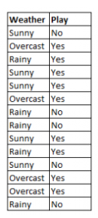
Math on Naïve Bayes
Q1. Given that the weather is “sunny”. Find the probability of ‘play No’ using Naïve Bayes Theorem .

Slide 2
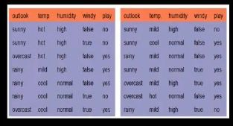
Q2. Given that the outlook is “sunny”, temperature is “cool”, humidity is “high” and windy. Find the probability of ‘play Yes’ using Naïve Bayes Theorem .

Slide 3
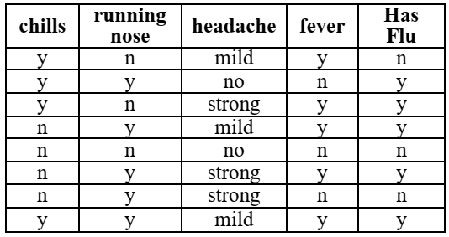
Q 3. A training dataset of a certain number of patient’s information and the corresponding target variable “Has Flu” are given below. Convert the dataset into a Frequency Table. Create a Likelihood Table and calculate the posterior probability. Can the doctor determine the status of the field „Has Flu‟ of a patient having chills, fever, and strong headache and without running nose? Use Naïve Bayes algorithm for classification.

Slide 4
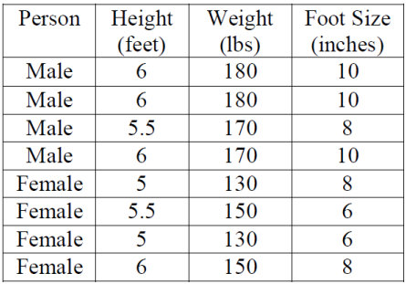
Q 4. A training dataset of person information and the corresponding target variable “Gender” are given below. Convert the dataset into a Frequency Table. Create a Likelihood Table and calculate the posterior probability. Determine the ‘gender’ of a person having height 6 feet, weight 130 lbs. and foot size 8 inch. Use naive Bayes algorithm for classification.

Slide 5
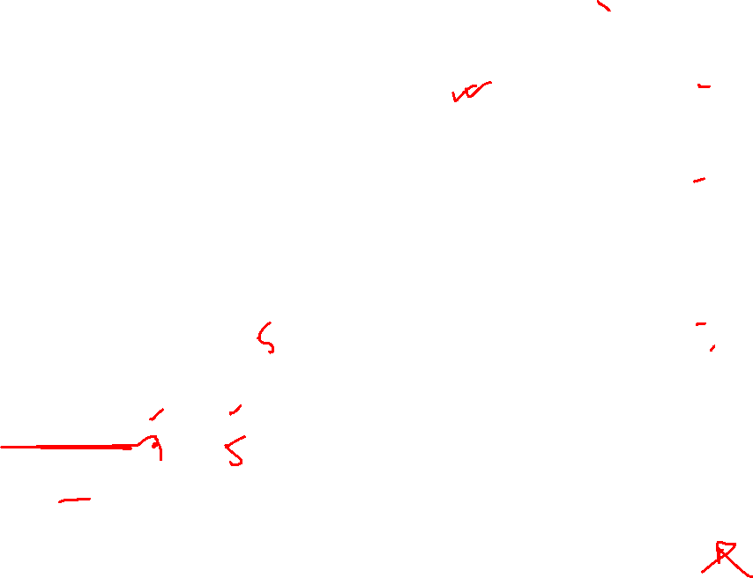


Slide 6


